Slide 1




By- Pseudonerds
The new automated solution to manage the official meetings through an online mode where we take care of all the services and the requirements, our employees need.

Slide 2




Team Members
Aishwarya Phirke
Atharv Dixit
AP
AD
JP
Jyoti Pachori
KP
Kopal Agarwal
Shreya Singh
Mohit Tilokchandani
SS
MT
Riya Kapoor
Prarthna
RK
P
Sumit Shrivastav
SS

Slide 3


Introduction
It is a web based application where we provide the facility to the employees of our company to bookoffline meetings through our application.
About
The process is made automated through our online services with an interactive and UI for the User to book and alter the meetings.
Feature
We have provided the feedback option in order to get insights from the Users with the aim to maintain our application in the long run.
Support

Slide 4
Features
Automate the procedure of creating and booking a meeting room.
We provide an interactive UI for the Users
Make bookings of meeting rooms in a company an easy task
The Authorised Users can securely use the application as per their requirements.
Meetings can be booked in the available meeting rooms with the ease of adding the needed amenities.
Our application shows all the available/booked rooms of a particular room typeon the UI.
Meeting Rooms can be created and midified as per the Requirements.
Meeting details can be accessed easily by logging in at any time.

Slide 5


Project Scope
Illustrating the roles of various Users
Admin
Manager
Member
The role of the Admin is the base of MeetPro.
He is the maintainer and the lead for creating the meeting rooms with multiple amenities.
The other responsibilities are
Delete a meeting room
Edit a meeting room
Imports the list of all the users
Rights to access all of the meeting rooms.
The role of the Manager comes after that of Admin.
He is the one responsible for creating the meetings and adding the concerned amenities based on the requirements of the type of meeting.
Also, he includes the members in the meetings.
He also can give feedback on the services used during the meeting span.
The role of the Member is simplistic as he is just a part of a meeting where he is required to attend. He can view the meeting details like the meeting room assigned, start time, end time and others.
He can also give feedback based on his experience.

Slide 6

Advantages
1. UX
Why Choose us?
2.Feature Set
Our Values and Feature Set are the main focus while delivering solutions to our Users.
3.Insatant Support
4.Provide Security
5.Complying Needs
6. User Satisfaction

Slide 7













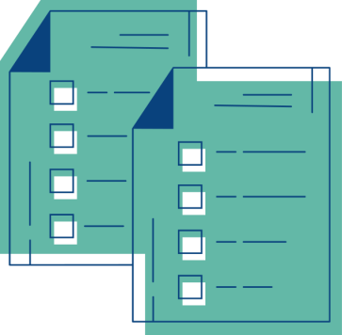








Technologies Used
HTML/CSS
MySql Database
Bootstrap
Java
Tomcat Apache Server
JSP
JavaServelet
JavaScript
JSON
Eclipse
Google Chrome
Postman
Canva

Slide 8
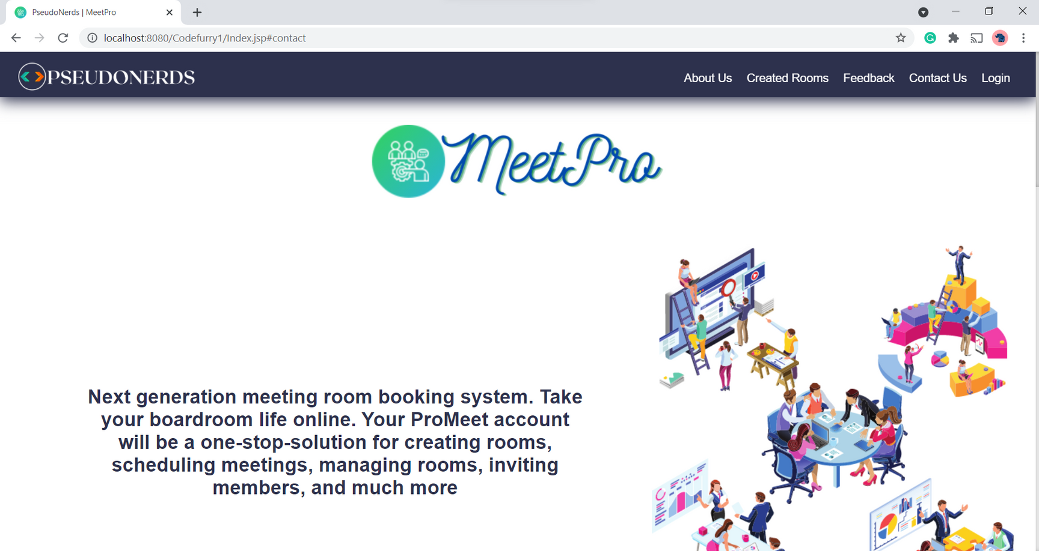
System Design
View Of Home Page

Slide 9
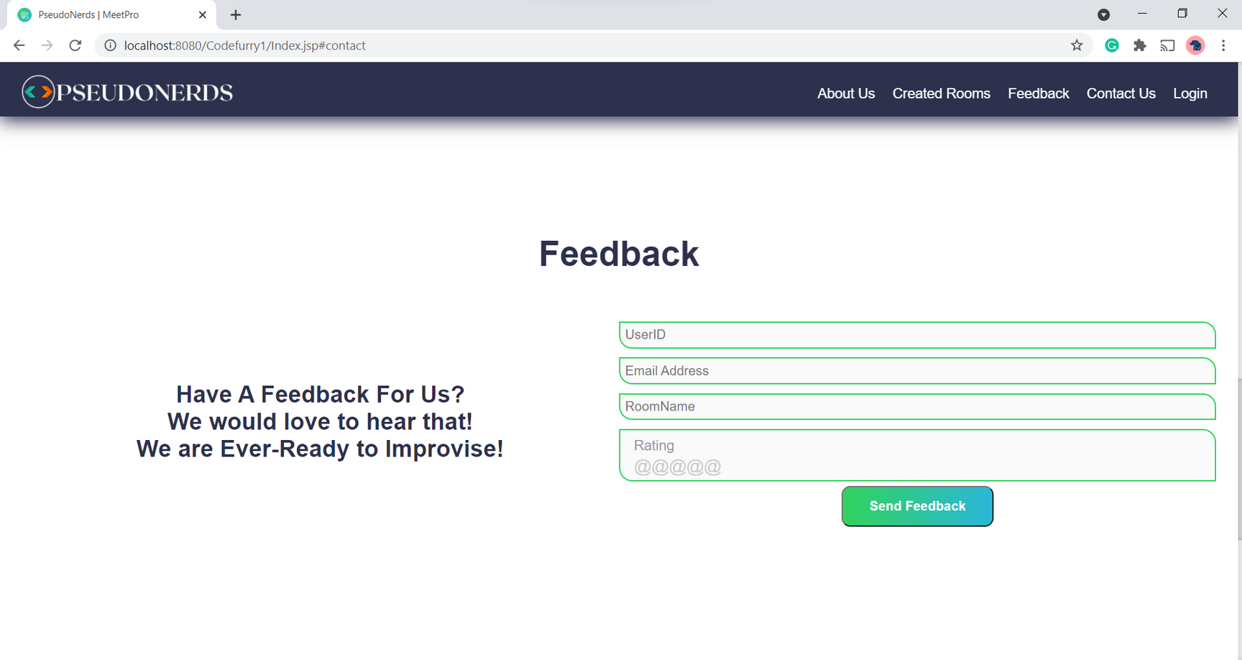
System Design
View of Feedback Section

Slide 10
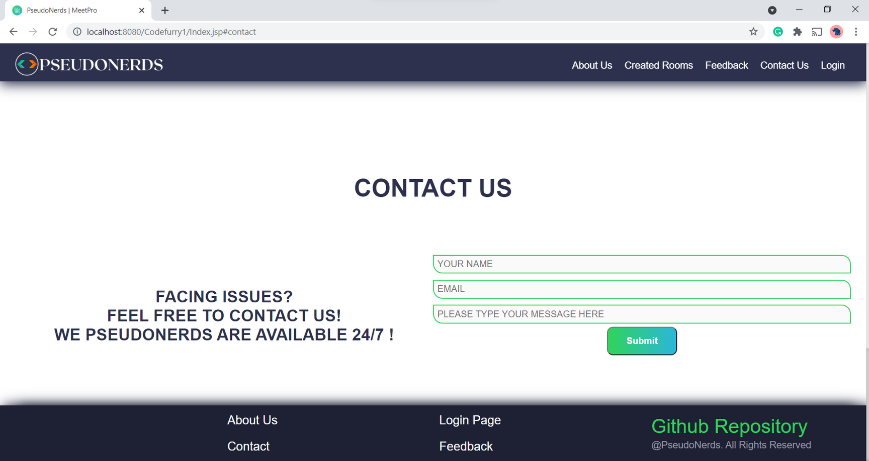
System Design
Contact us Section

Slide 11
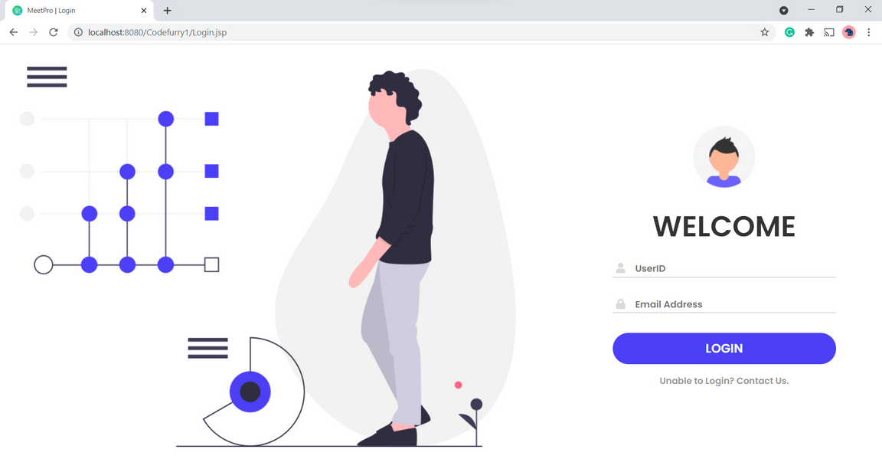
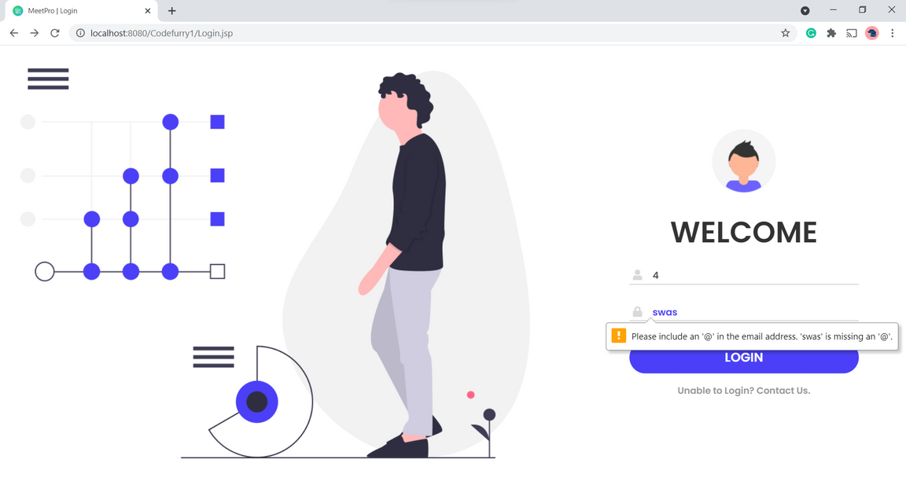
System Design
Login Page

Slide 12
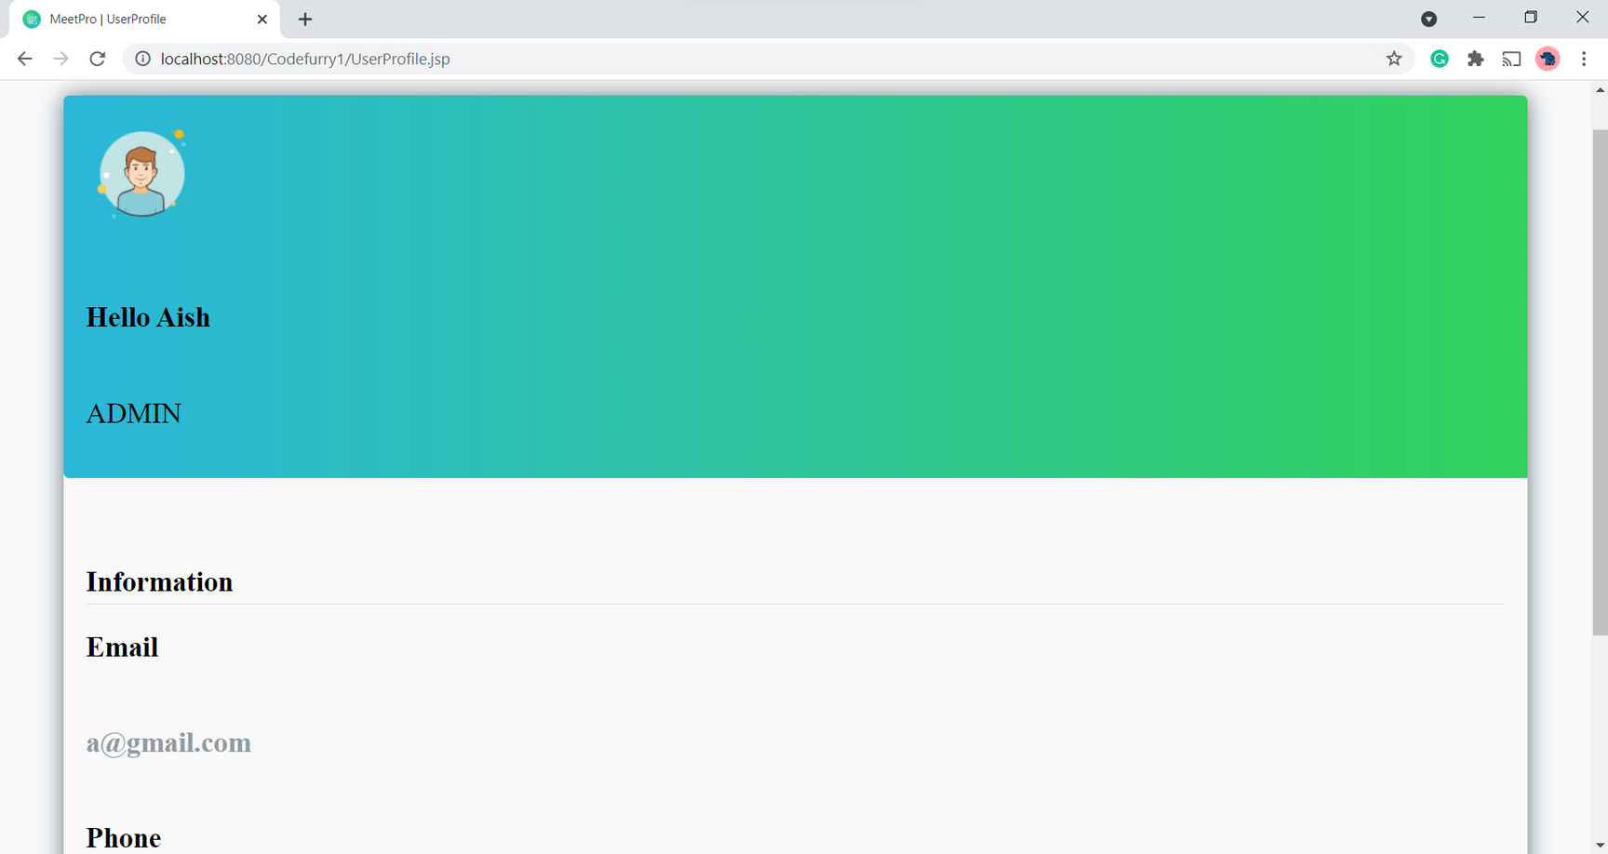
System Design
View of Profile Details

Slide 13
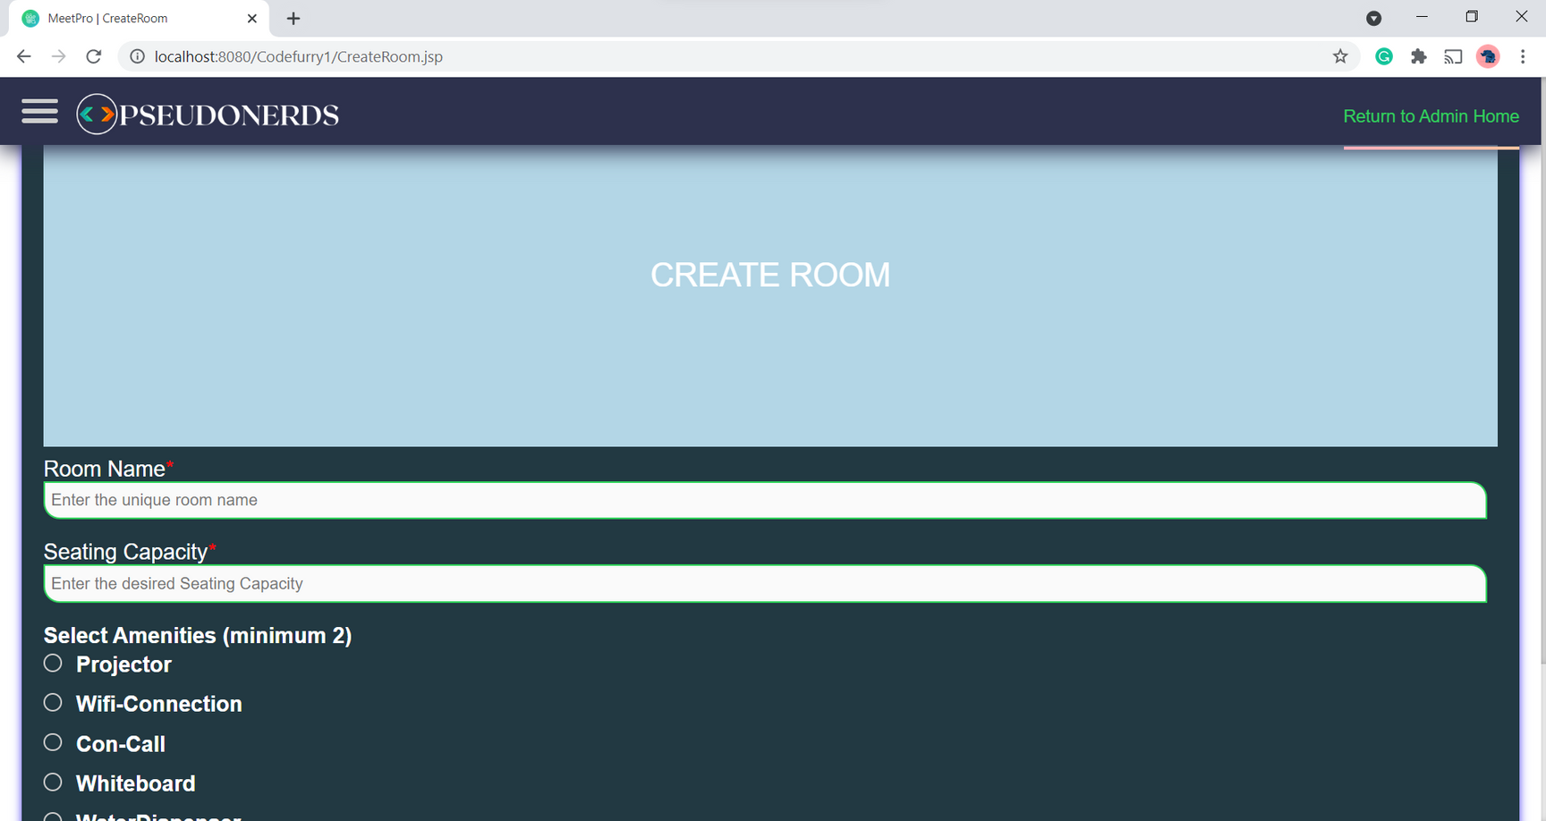
System Design
View of Creating Meeting Room

Slide 14
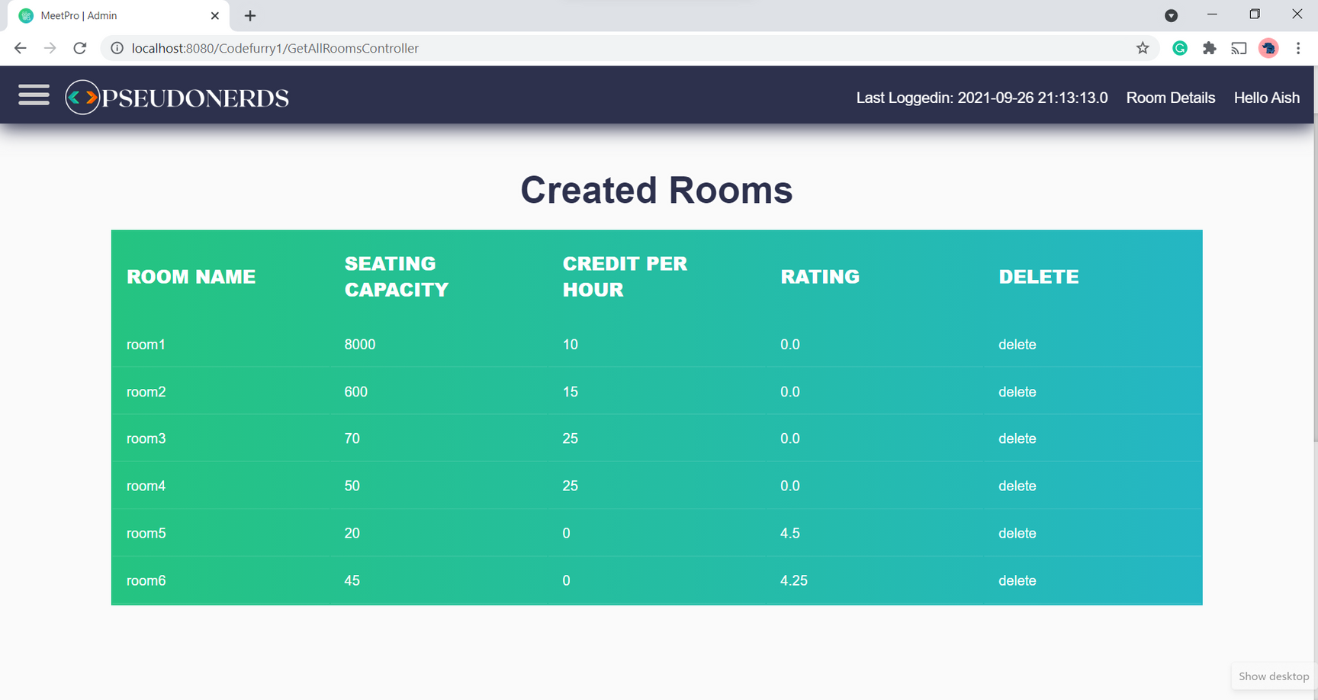
System Design
View of Created Rooms

Slide 15
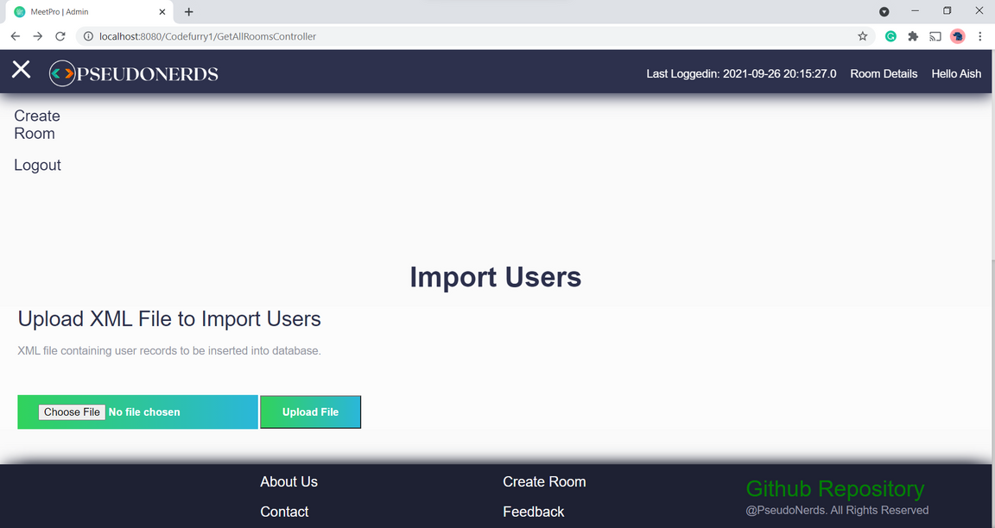
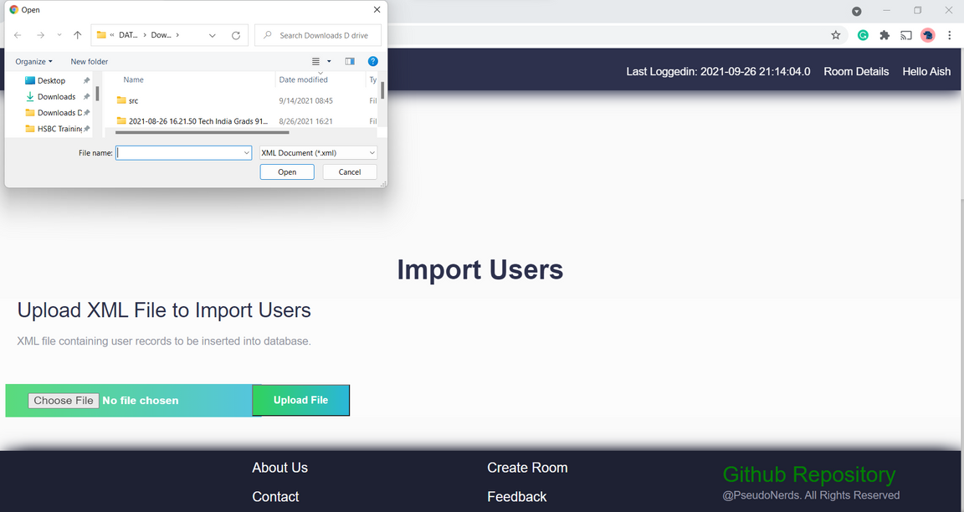
System Design
View of Import Users

Slide 16
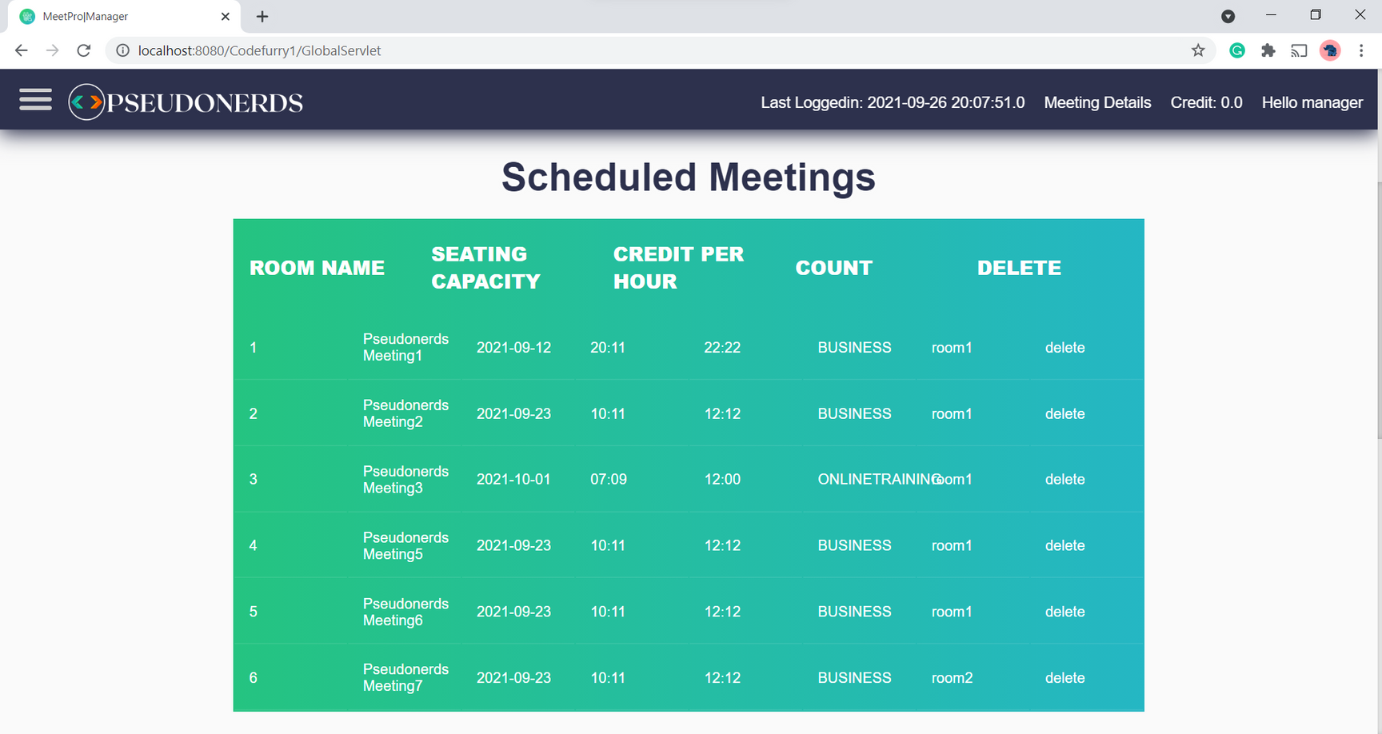
System Design
View of Scheduled Meetings

Slide 17
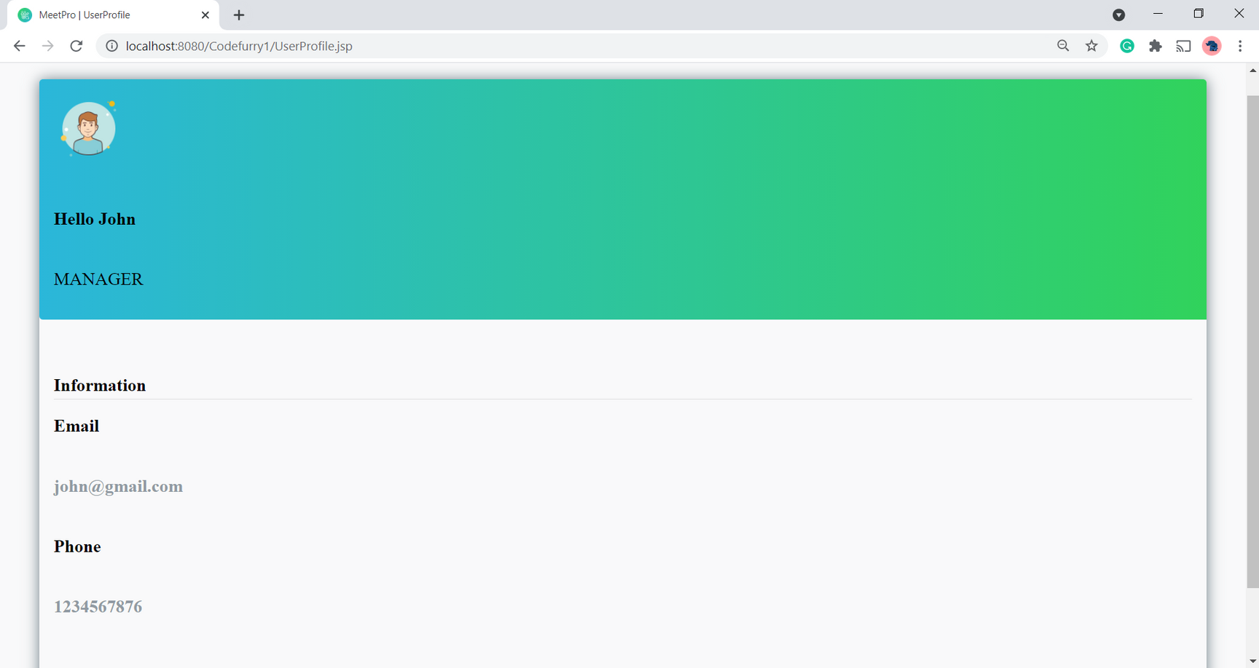
System Design
View of Profile Details

Slide 18

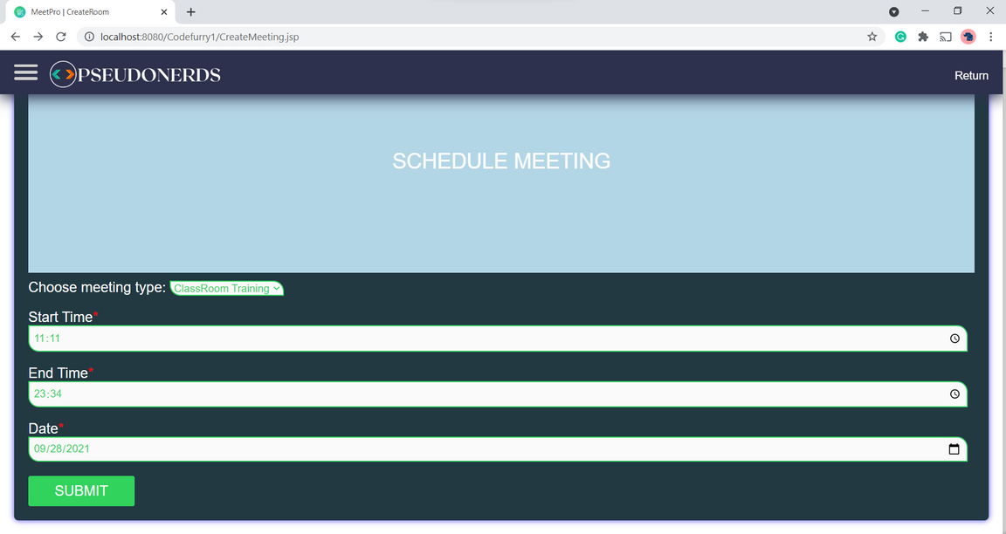
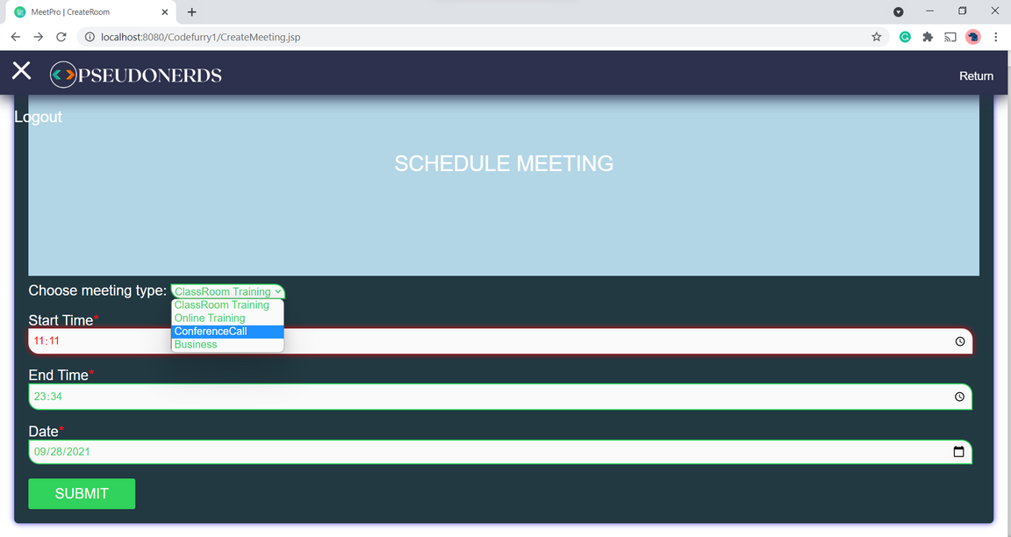
System Design
View of Schedule Meetings

Slide 19

Learning Highlights
Team Work
Deep Dived into GitHub's Fundamentals
Integration of various technologies
Channels
Learned a lot about Resolving Errors.
Manage work within a limited period with the aim of providing perfection
Conceptualization and organization of the entire project from scratch.

